Slide 2
HORNETSECURIY’S ALTARO VM BACKUP FOR MSPS

Slide 3
AGENDA
About Hornetsecurity
Altaro VM Backup for MSPs
Outstanding 24/7 support
Contacts & resources

Slide 4
ABOUT HORNETSECURITY

Slide 5
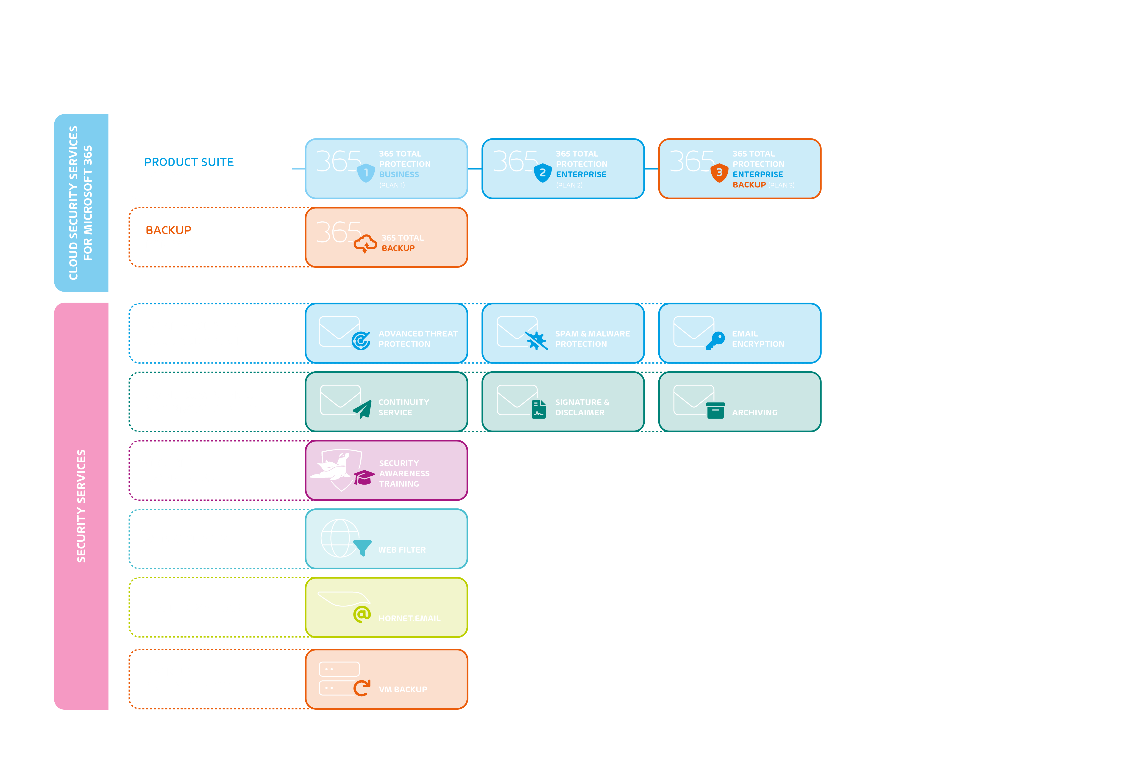

Slide 6
BACKUP POWERHOUSE FOR MSPS
Solutions specifically built for Managed Service Providers (MSPs) and IT consultants
Monthly subscription – no binding contracts
The only vendor that enables MSPs to manage different kinds of backups across all their customers from a single pane of glass
Ground-breaking, multi-tenant online management console
One monthly invoice for all the backup services used by an MSP’s different customers

Slide 7
50,000+ CUSTOMERS ARE USING OUR SOFTWARE
Our customers are mainly small and mid-market businesses – but our scalable solution also hits the spot for industry leaders!

Slide 8
REVIEWERS & CUSTOMERS RAVE ABOUT US…
“We found it to be a pleasant, easy-to-use program that was easy to set up in an intuitive way … It is easy to see at a glance where we are in relation to continuity, especially thanks to the solution’s multi-tenant management console.”
“You have provided a product that is very reliable. It is very easy to implement, and it just works … In a disaster recovery scenario, I have full confidence in restoring a backup.”
Ed Klotz, Co-Founder and Vice Present of Design & Implementation
Brett Casterton, Technical Director
… and we get a lot of love from the SpiceWorks community too – more than 160 five-star reviews

Slide 9
REVIEWERS & PARTNERS RAVE ABOUT US…
Québécom needed more efficient backup solution to replace the one they’d had and they picked Altaro VM Backup due to its customer service and because, in their words, it’s a:
“Stress-free backup solution with cloud dashboard and easy setup of an offsite backup server.”
Case study: Québécom – Hornetsecurity Partner
Industry: IT services
Employees: 10-20
Interviewee: Alexandre Grenier

Slide 10
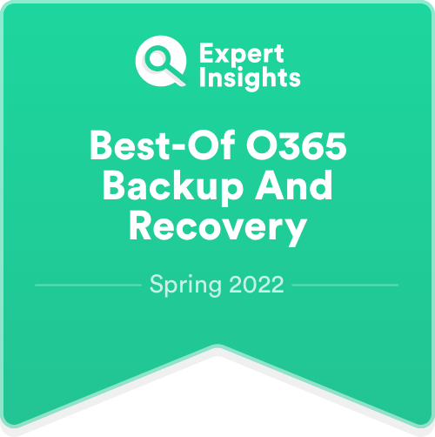
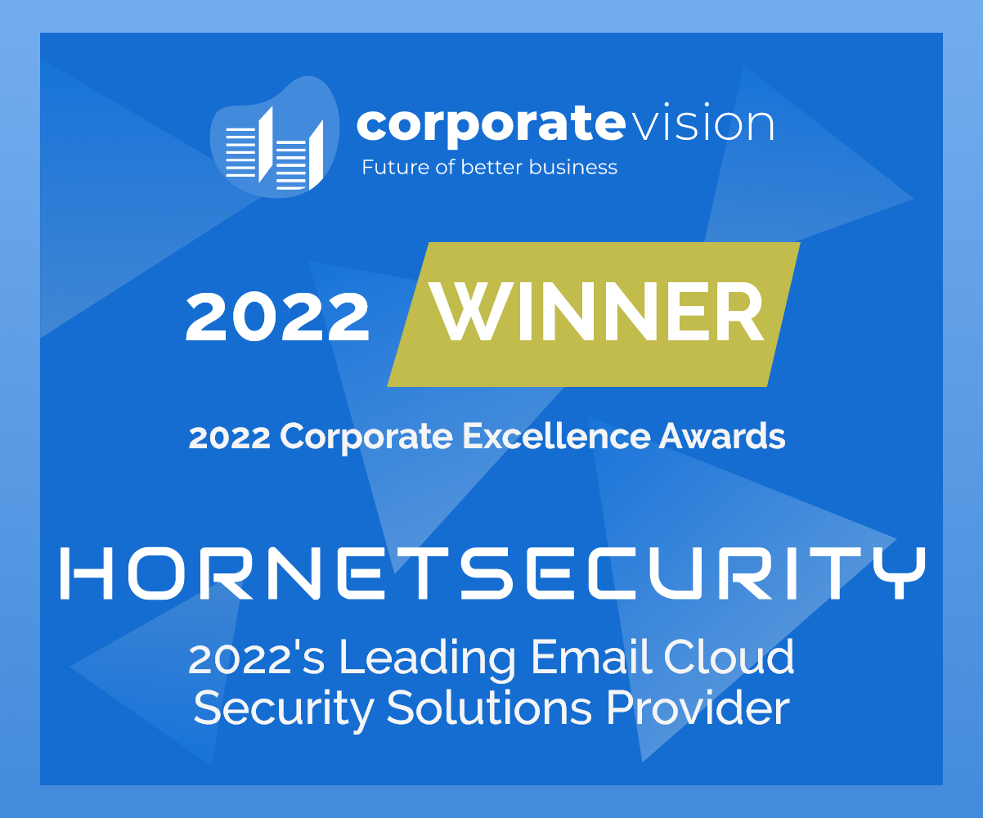
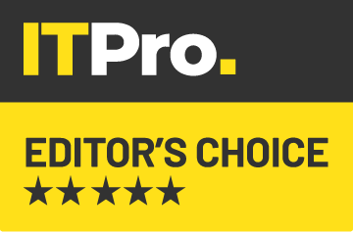
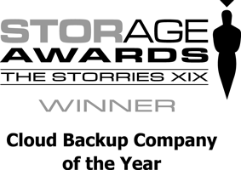
WALL OF FAME:
HIGH-PERFORMANCE AWARDS FOR OUR SERVICES

Slide 11
VM BACKUP FOR MSPS

Slide 12
OVERVIEW
Altaro VM Backup for MSPs allows you to provide Hyper-V, VMware and physical server backup, replication and recovery services to all your customers from a central online console at the most accessible price in the industry​
Back up your customers’ VMs and any physical servers using Altaro VM Backup on a monthly subscription​
Pay per VM and any physical Windows servers backed up per month​
No upfront costs​
No binding contracts​
No risk​
And you can centrally manage and monitor all your customers through the multi-tenant Control Panel, a Cloud Management Console

Slide 13
BENEFITS OF THE ALTARO VM BACKUP FOR MSPS PROGRAM
Multi-tenancy: Manage and monitor all your customers' VM and physical server backups and replications through a multi-tenant Cloud Management Console
Praise-winning 24/7 support: Outstanding 24/7 support with prompt call pickup of less than 30 seconds. An industry best!
Pay per VM: Pay per VM and per physical server per month at the most accessible price in the industry with no upfront fees
Recurring revenue: Charge your customers a monthly recurring fee for backups, your services and (optionally) storage used
No contracts: Minimum monthly subscription of up to 10 VMs per month, with no binding contracts; scale up to 1,000s of machines

Slide 14
BENEFITS OF THE ALTARO VM BACKUP FOR MSPS PROGRAM
Provide offsite storage: Back up and replicate your customers' VMs and any physical servers to their servers, the cloud or your own servers and bill for storage used
Access to all features: Access the most current and feature-rich version of Altaro VM Backup Unlimited Plus Edition to use across all your customers, at no extra fee
Reliable backup service: Provide your customers with reliable VM and physical Windows server backup and recovery services (BaaS), charging a monthly fee for managing their backups on their or your servers
Market leading deduplication: Leverage our signature market-leading deduplication with an average of 64% less storage requirements

Slide 15
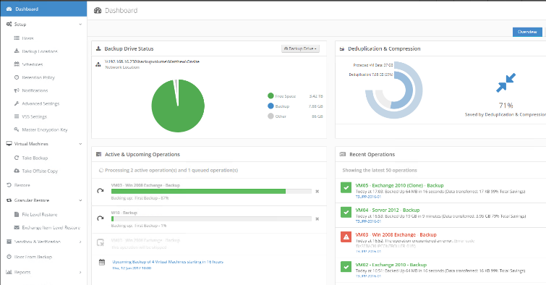
BACKUPS EXECUTED THROUGH ALTARO VM BACKUP
Hassle-free backup of both Hyper-V and VMware VMs, as well as any physical Windows servers
Designed to be easy to use and deploy – 15 minutes to install, minimal ongoing maintenance

Slide 16
EVERYTHING YOU NEED IN A BACKUP SOLUTION:
Advanced backup – Deduplication (63% average savings - best in the industry!), offsite replication, multiple offsite backup locations, scheduling, etc.
Fully supports Hyper-V Clusters (CSV & SMB3) and VMware vCenter
Support for Azure Stack HCI
Optimized performance – Fast, small backups, easy on resources
Powerful restore – File and Exchange item-level restore, boot from backup, cloning, restoring to different hosts, etc.

Slide 17
CLOUD BACKUP TO MS AZURE, AMAZON S3 AND WASABI Select the cloud storage provider you prefer
Native integration with MS Azure, Amazon S3 and Wasabi
Uses cloud storage in the most cost-effective way
Fast and easy
Secure and seamless data transfers
Restores to different Altaro VM Backup installations
No additional resources required; resulting in savings
Supports our compression, encryption and industry-best deduplication; resulting in the lowest storage requirements

Slide 18
ALTARO VM BACKUP FOR MSPS PRICING INFO Most accessible price in the industry
Pay per VM per month and per physical server per month
Starting subscription of 10 VMs per month across all your customers
Price includes full access to Control Panel and license for the latest edition of Altaro VM Backup to use across your subscription customers (i.e., no other licenses needed for Altaro VM Backup, it’s all included in one monthly fee)

Slide 19
TAILORMADE FOR YOUR NEEDS
SMALL TO MEDIUM MSPS
LARGE MSPS
Grow your MSP business faster with Altaro
Multi-tenant online console - Save time and money through centralized management of all your customers
Pay per VM and any physical Windows servers backed up per month at the most accessible price in the industry
Start small and scale up to 1,000s of machines – No binding contracts
Outstanding 24/7 support - Instant, expert help at your fingertips, as part of the package
Benefit from personalized, speedy service
Multi-tenant online console – Manage all your customers through one central view, for easy monitoring and billing
Scalable to fit your needs – Easily manage 1,000s of machines across 100s of customers
Dedicated 24/7 support – Speak direct to experts, fast; call response of <30 seconds; no gatekeepers
Direct access to the CEO and C-level team
Join thousands of successful MSPs that partner with us.
Join other CRN Top 500 MSPs like:

Slide 20
NEW PRODUCT VERSION: VM BACKUP V9
The latest version of VM Backup will be released soon and will include the following new features:
Ransomware protection via Immutable Cloud Storage using Wasabi, Amazon S3 and Azure
Backups are protected using immutable cloud storage Data cannot be deleted, modified, or removed by anyone for a set duration
Benefits:
Tamper-proof protection of backup data whilst it is under the defined immutable policy
Fulfillment of compliance requirements of insurance companies and within the framework of the GDPR
Data cannot be changed or deleted by any user (including administrators or root)
Notes:
Pain Point Ransomware-Angriffe können sich eines Cloud-Speicher-Kontos bemächtigen und die Daten verschlüsseln, wodurch sie unbrauchbar werden
Unbefugte können sich eines Cloud-Speicher-Kontos bemächtigen und den Inhalt löschen, so dass ein Nutzer seine Sicherungsdaten verliert.
Ziel von V9
Ermöglichen, dass Daten in Cloud-Speicher-Konten nicht editierbar und nicht löschbar sind, um sich vor Ransomware und böswilligen Akteuren zu schützen, die in der Lage sein könnten, Daten zu löschen.
Es gibt verschiedene Anwendungen für einen solchen unveränderlichen Cloud-Speicher, darunter
Schutz vor Ransomware - Es wird sichergestellt, dass Daten nicht überschrieben werden können, sobald sie im Speicher abgelegt sind, so dass ein Angriff, der versucht, Daten zu ändern, keine Datenunterbrechung verursacht.
Schutz vor dem Löschen von Speicherkonten - Erlaubt nicht das Löschen (im Falle von Azure, eines Azure-Speicherkontos), wenn unveränderliche Richtlinien angewendet werden.
Einhaltung von Vorschriften - Hilft Unternehmen bei der Erfüllung von Compliance-Anforderungen (z. B. SEC 17a-4(f), CFTC 1.31(d), FINRA und andere Vorschriften).
Sichere Dokumentenaufbewahrung - Stellt sicher, dass Daten von keinem Benutzer geändert oder gelöscht werden können, auch nicht von Benutzern mit administrativen Rechten für Konten.
Legal Hold - Ermöglicht Benutzern die manipulationssichere Speicherung sensibler Informationen, die für Rechtsstreitigkeiten oder geschäftliche Zwecke wichtig sind, für die gewünschte Dauer, bis die Sperre aufgehoben wird.
Überblick
Immutable Storage ermöglicht es Benutzern, geschäftskritische Datenobjekte in einem WORM-Status (Write Once, Read Many) zu speichern. In diesem Zustand sind die Daten auf unbestimmte Zeit oder für einen bestimmten Zeitraum nicht löschbar und nicht änderbar.
Altaro VM Backup v9 unterstützt nur die Sicherung auf unveränderbarem Speicher, d.h. wir verwenden vorhandene unveränderbare Speicher wie Azure und S3, wir implementieren NICHT unseren eigenen unveränderbaren Speicher wie andere Anbieter.
Ziel-Benutzer
Diese Funktion gilt für Altaro und Hornet MSPs und Endbenutzer mit der erforderlichen Lizenz - MSP oder EU-Abonnement Unlimited Plus

Slide 21
OUTSTANDING 24/7 SUPPORT – AT NO EXTRA COST

Slide 22
24/7 SUPPORT – “THE BEST IN THE IT INDUSTRY”
“You are the best company I’ve ever been in touch with when it comes to customer support!”
- Wenche Ostmo, Ministry of Justice and Public Security
"Excellent and fast support response for an excellent backup program! You guys really know what your customers need, and that’s fast support! Most companies ‘forget’ support after the purchase of the product/service but not you." - Jan Theo Hoekstra, Managing Director/System Integrator, Winadmins
“Excellent customer satisfaction and… outstanding customer service and technical know-how. KUDOS: out of the hundreds of vendors I deal with, you are in the top 5% of excellence." - Doug Claxton, CTO/Senior Project Manager; Technical Solutions Expert, LANmaster

Slide 23
SIGNING UP & CONTACTS

Slide 24
CONTACTS & RESOURCES
Customer Service – sales@altaro.com
For all issues related to quotes, orders, keys etc.
Support – support@altaro.com UK: +44 203 397 6280 | US: +1 919 251 6280 | DE: +49 22 15998 8986
For all technical issues
We mark all partner support requests for priority support
Live chat on website and from within the product for immediate answers
http://support.altaro.com
Support Center & Knowledgebase: http://support.altaro.com
Partner area: http://portal.altaro.com Also for quick access to downloads and marketing materials
If a partner has an important deal and they need us on standby, email support@altaro.com

Slide 25
NEXT STEPS
For a 30-day trial of our MSP subscription program:
OR contact sales@altaro.com or your distributor
START MY FREE TRIAL

